Slide 1

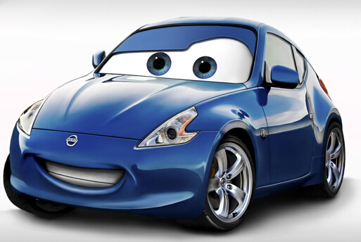
Car Evaluation
CS513-final project
Professor Mahmoud Daneshmand
Junsheng Liu

Slide 2

contents
Overview of CRISP-DM
Business understanding
Data understanding
Data preparation and analysis
Modeling and evaluation(decision tree and KNN)
Deployment and conclusion
Reference

Slide 3
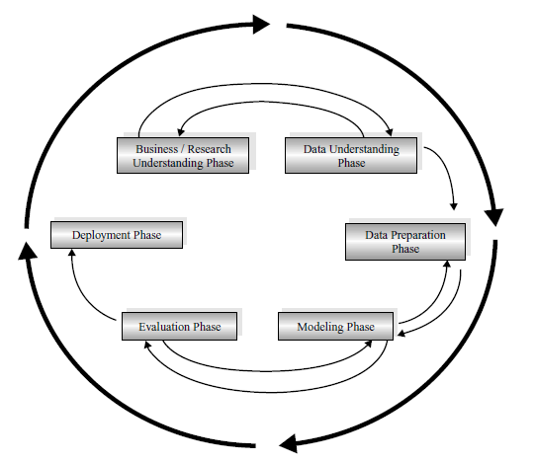
Overview of CRISP-DM
We will use CRISP-DM method to deal with this
Project. CRISP-DM contains 6 phases:
1. Business understanding phase
2. Data understanding phase
3. Data preparation phase
4. Modeling phase
5. Evaluation phase
6. Deployment phase

Slide 4

Business understanding
How to evaluate a new car? Which is the most important feature for people to jungle a good car? Different people may have different opinions about a car. Price, comfort, or safety. But automakers want to find similarity and want to know which factor is the most important so that they can make right choice to adapt people’s favor and improve efficiency of their company .

Slide 5
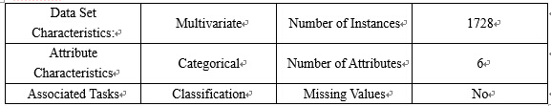
Data understanding
The data is coming from UCI Machine Learning Repository. And it was derived from a simple hierarchical decision model originally developed for the demonstration of DEX, M. Bohanec, V. Rajkovic.

Slide 6
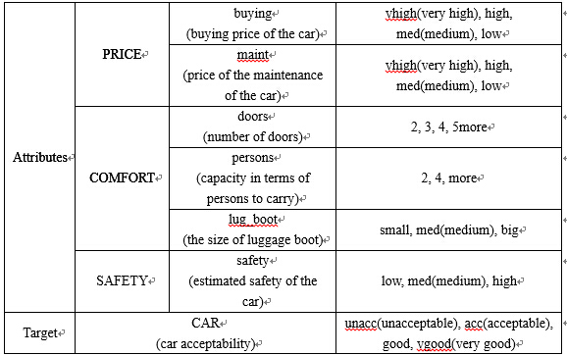
Data understanding
Dataset information: 6 attributes(buying, maint, doors, persons, lug_boot, safety) and a target(CAR) and their values are following:

Slide 7
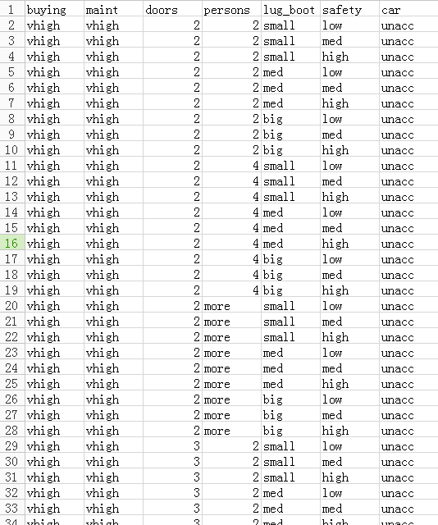

Data understanding
Here are the
sample data :

Slide 8
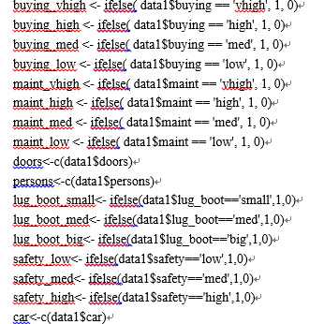
Data preparation and analysis
In this phase, we need to handle the data. Since there is no missing values and outliers, what we need is to normalize the data. We can change the categorical values into numerical values using R.

Slide 9
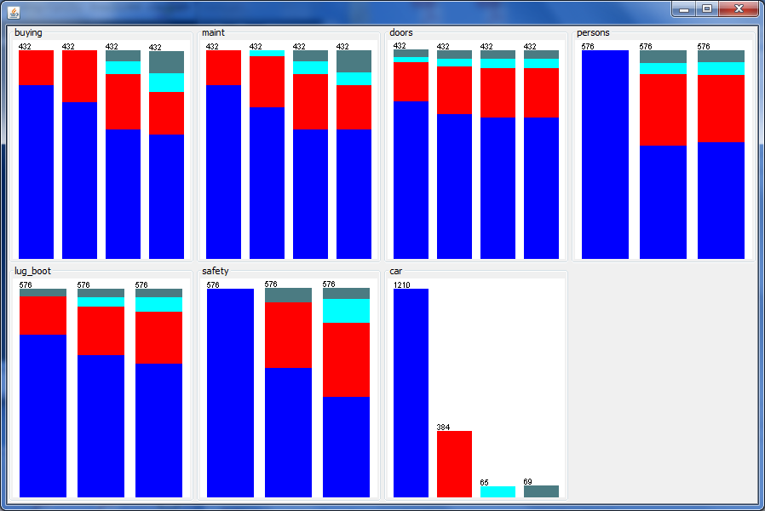
Data preparation and analysis
The figure of histogram of data left is about the proposition of each target value to every value of the attribute. For example, in the buying histogram, four column are corresponding to the value “vhigh”, ”high”, ”med” and ”low” of buying. The four kinds of colors are corresponding to the value “unacc”, “acc”, “good” and “vgood” of CAR.

Slide 10
Data preparation and analysis
From the histogram, at least we can see that most people can not accept a car with very high buying price, very high the maintenance price, 2 doors, capacity in terms of 2 persons to carry, small size of luggage boot and low safety. And most people evaluate a very good car with low buying and maintenance price, capacity of more than 2 persons, high safety, big size of luggage boot.
Also, this result is exactly consistent with our common sense. But which attributes are most important for consumers? Next, we will use model to get an accurate result.

Slide 11
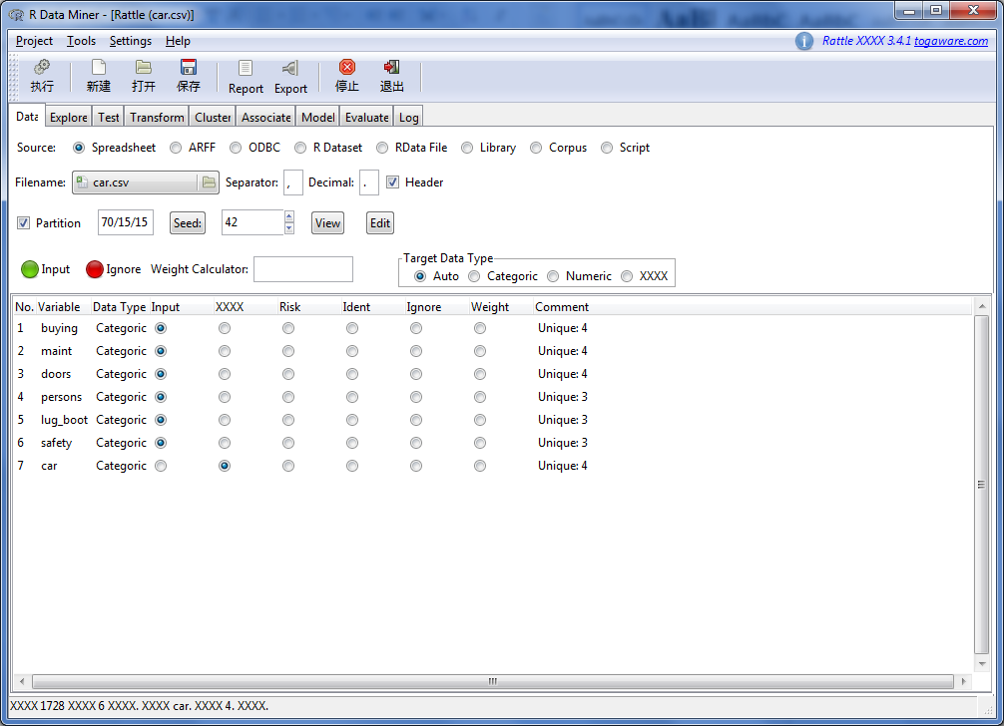

Modeling and evaluation
(decision tree)
We first use decision tree method to model our project and then use k-nearest neighbor method. Here is the decision tree method:
Rattle within R can help
us to get the decision
tree.

Slide 12
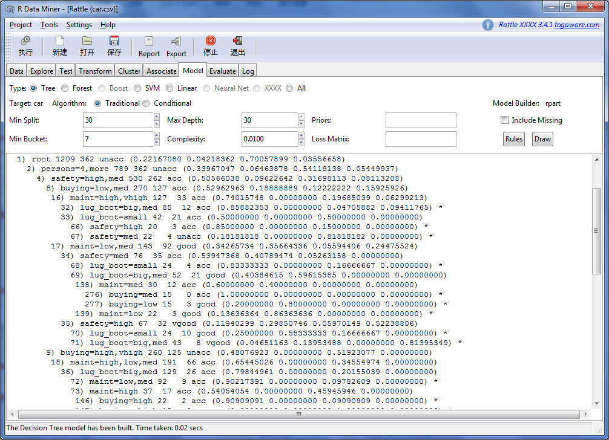
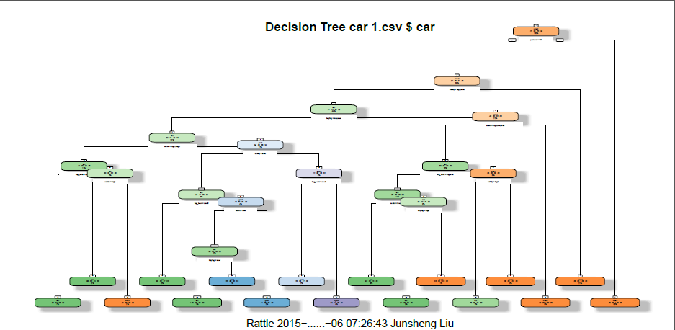
Modeling and evaluation
(decision tree)
Decision tree model
Plot with decision tree

Slide 13
Modeling and evaluation
(decision tree)
A 70% subset of all the data are used to build our model. Provided by Rattle, we obtain the plot of decision tree which gives us a better idea of the decision tree. Decision tree model is a kind of classification method. For example, with 1209 root nodes, 70.1% of them, i.e. 363 nodes’ target values are “unacc”. Further, if the attribute persons is “4” or “more”, safety is “med”, buying is “low” or “med”, maint is ”high” or “vhigh”, lug_boot is “small”, then there are only 4 people of 22 people that are not unacceptable of the car. That is to say, in this situation, we have 81.8% confidence level that this people would not accept with the car. However, according to the same situation except safety is “high” instead of “med”, then we have 85% confidence level that this people would accept that car.

Slide 14
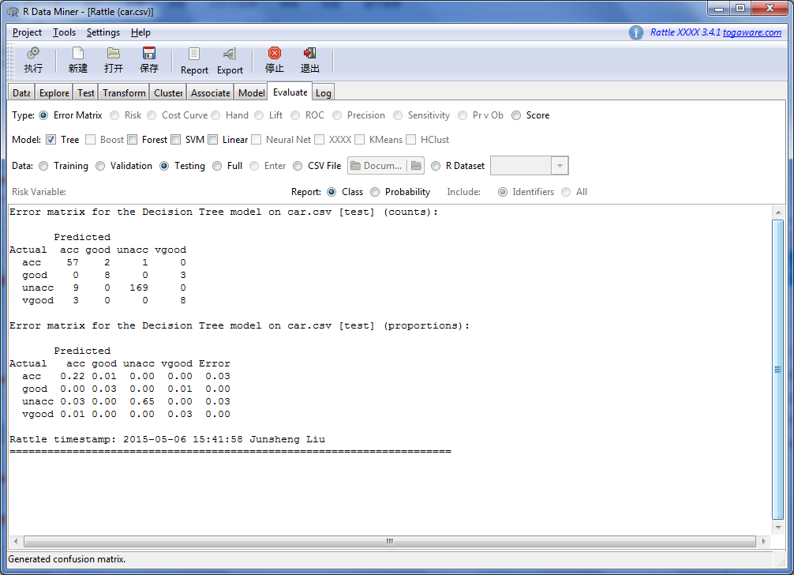
Modeling and evaluation
(decision tree)
Here we have the evaluate error with the error matrix using testing dataset for the decision tree model. In Rattle, a 15% subset of data are used as testing dataset. Testing dataset is used to evaluate the unbiased error of the result. In Figure, the first table is about the actual counts of observations and the second table is about the percentages. We can see that about 93% of the evaluation of the model is correct. That is to say, we have about 93% confidence level that the model is accurate.

Slide 15
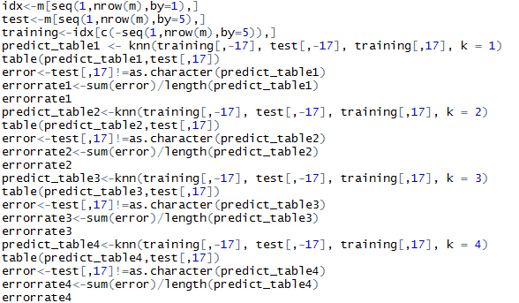
Modeling and evaluation
(KNN)
Next, we use k-nearest neighbor method by programming with R language. K-nearest neighbor algorithm is often used for classification, estimation and prediction. It uses neighborhood observations to estimate a new record with the similar attributes. In the model, We store every 5 records to test dataset and choose k=1, 2, 3, 4. k=i means choose the nearest i records to estimate the new records.

Slide 16
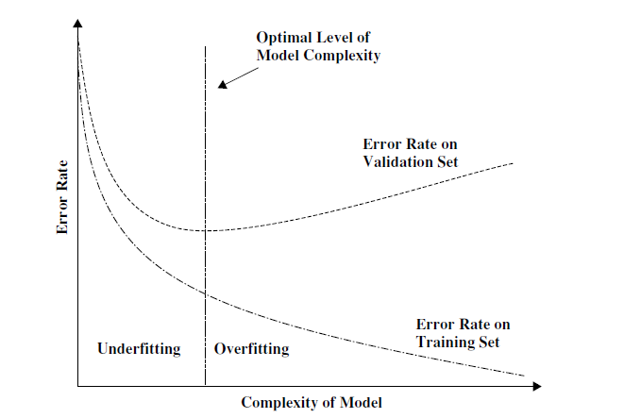
Modeling and evaluation
(KNN)
In the textbook Discovering Knowledge in the Data, as a model complexity increases, the validation set error rate soon begins to flatten out and increase, as shown in the Figure
However, in our project, most value are categorical, even some other values are numerical, such as values of doors, but there are only 4 values and the distance of two values is big enough. So in our common sense, the error is the smallest if k=1.

Slide 17
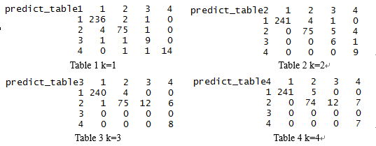
Modeling and evaluation
(KNN)
Here are the prediction errors of k=i:
When k=1, error rate is 0.0347. When k=2, error rate is 0.0434. When k=3, error rate is 0.0665. When k=4, error rate is 0.0694.. We can notice that the error is increasing, as we say before. So we choose k=1 for k-nearest neighbor method. And we know that the confidence level for k=1 is 96.53%.
Both the k-nearest neighbor method and decision tree method have their own advantages. By combining and comparing the two methods, we can make our conclusion more convincing.

Slide 18
Deployment and conclusion
After evaluating the results from the two model, we can see that we use decision tree model to get 93% confidence level and KNN model to get about 96.53% confidence level and we obtain the information that most people cannot accept a car with very high buying price, very high the maintenance price, 2 doors, capacity in terms of 2 persons to carry, small size of luggage boot and low safety.
We notice the order of importance follows the factors: capacity in terms of persons to carry, estimated safety of the car, price of the maintenance of the car and so on. Since if persons is “2”, people with 100% confidence level would not be acceptable with the car no matter what other attributes the car has. And if the attributes persons is “4” or “more” and safety is “low”, no matter what other attributes the car has, people with 100% confidence level also would not be acceptable with the car.

Slide 19
Deployment and conclusion
In conclusion, for automaker, they should focus more on capacity and safety according to our project, which will help them to do well in business and make right choice to improve efficiency of their company theoretically. If we have more records and more attributes, we can also use KNN and decision tree to model, and obtain a more accurate conclusion.

Slide 20
Reference
1. Discovering Knowledge in Data: An Introduction to Data Mining, By Daniel T. Larose
2. Data Mining with Rattle and R: The Art of Excavating Data for Knowledge Discovery, By Graham Williams
3. Data source: http://archive.ics.uci.edu/ml/datasets/Car+Evaluation

Slide 21
Thank you for watching!

